Slide 1


The Revit Standards officially recognised as an Open Standard
Mark Wieringa
Revit Standards Foundation - Chairman
Bimforce

Slide 2


Why do we use Standards?

Slide 3

Why do we use Standards?

Slide 4
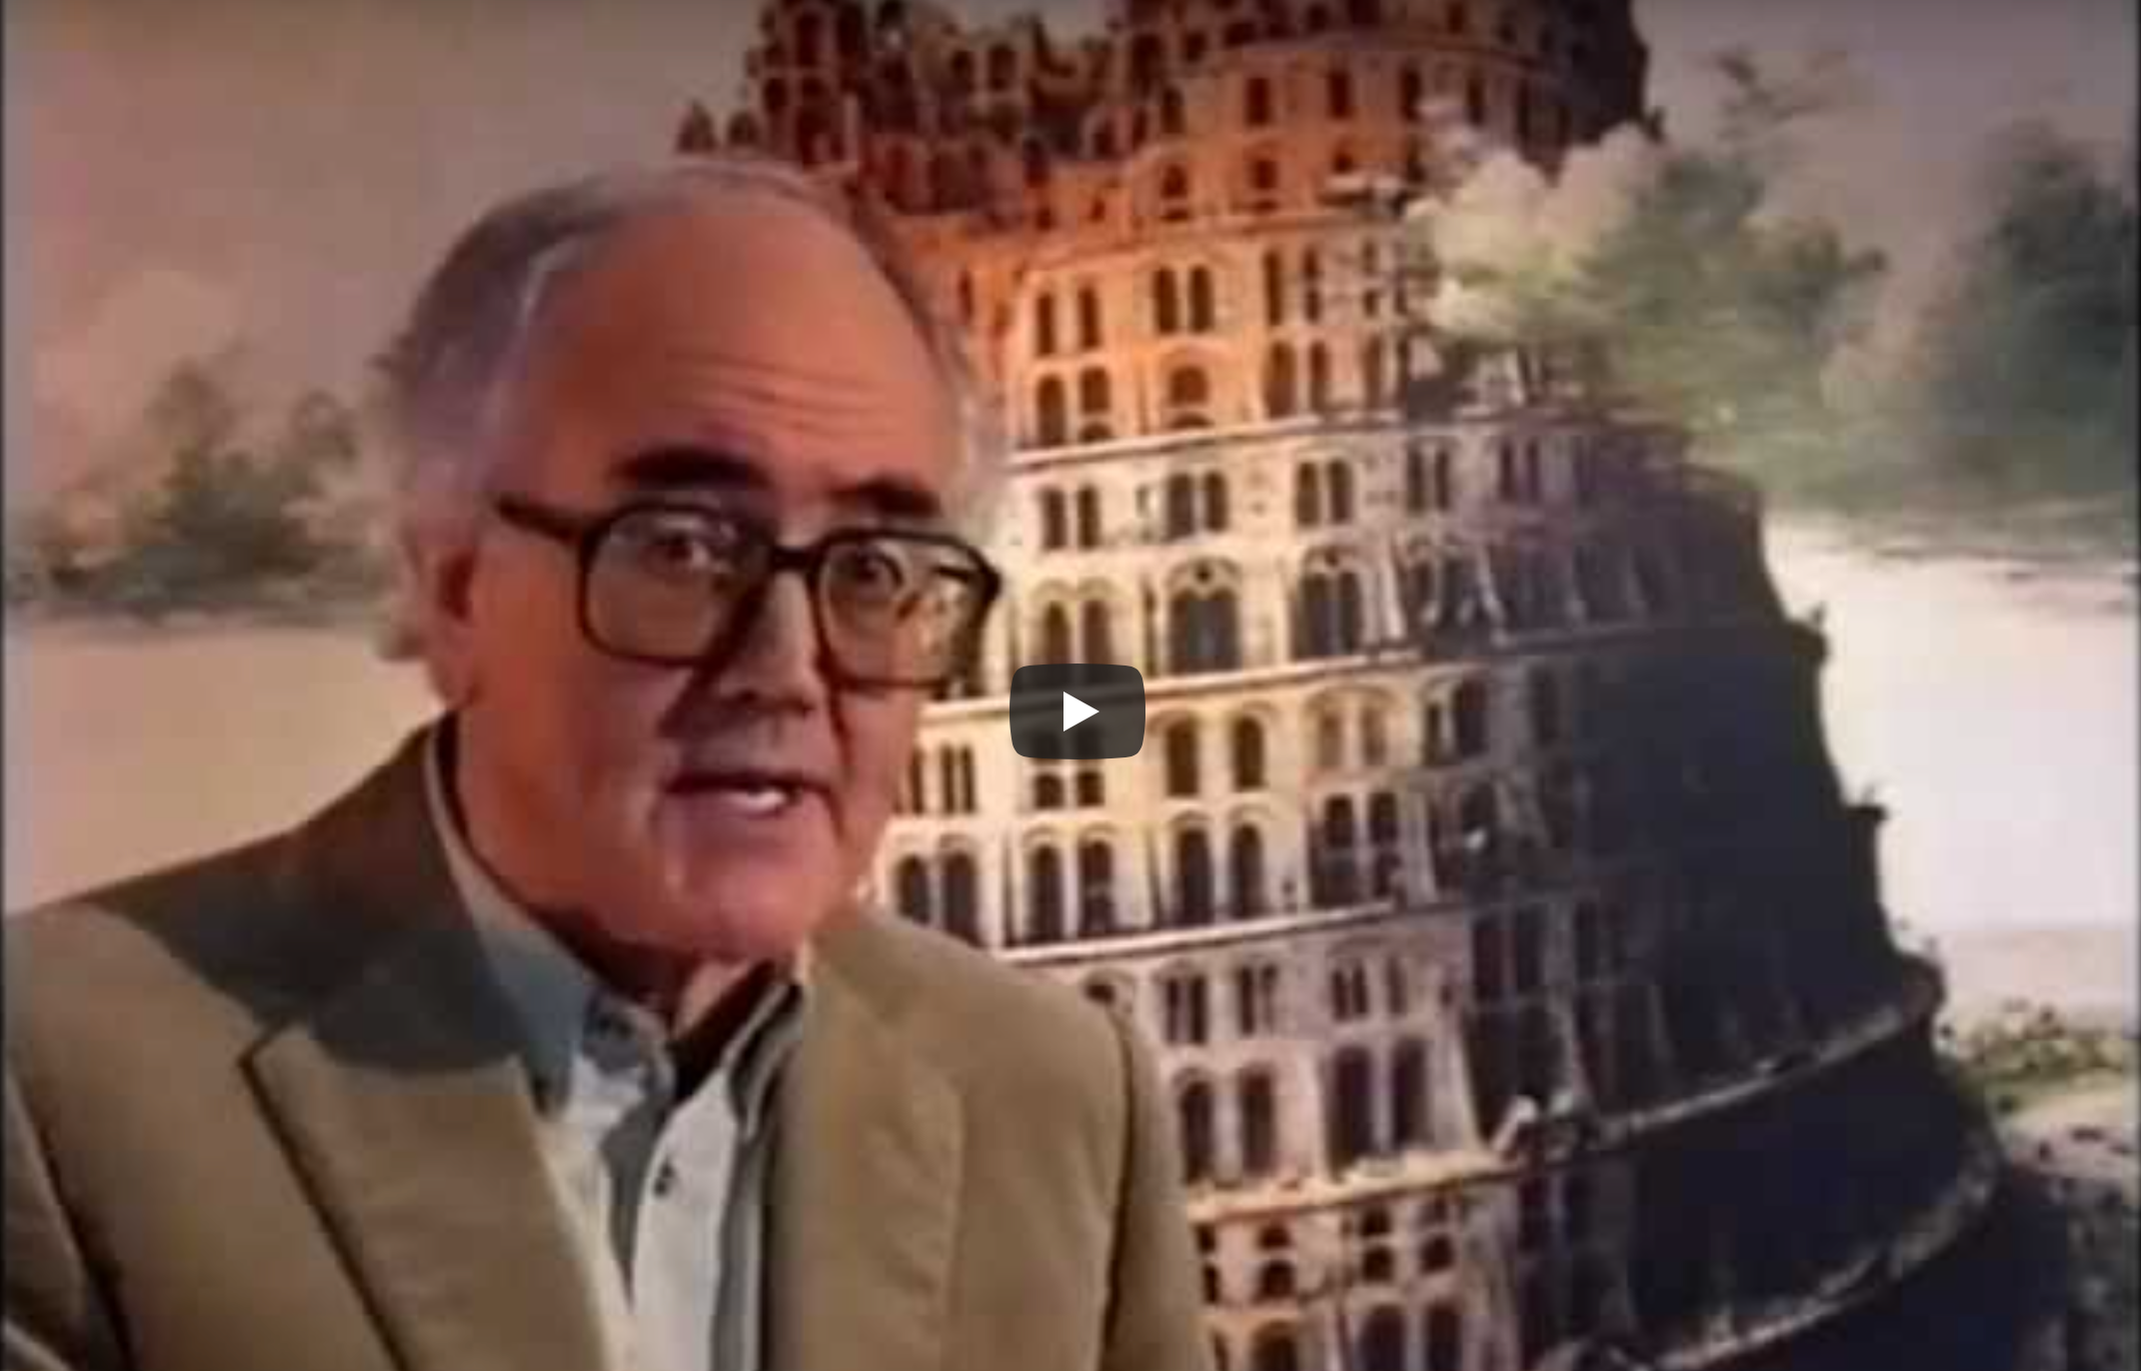
Why do we use Standards?
https://www.youtube.com/watch?v=g_jmGQvr6dQ

Slide 5
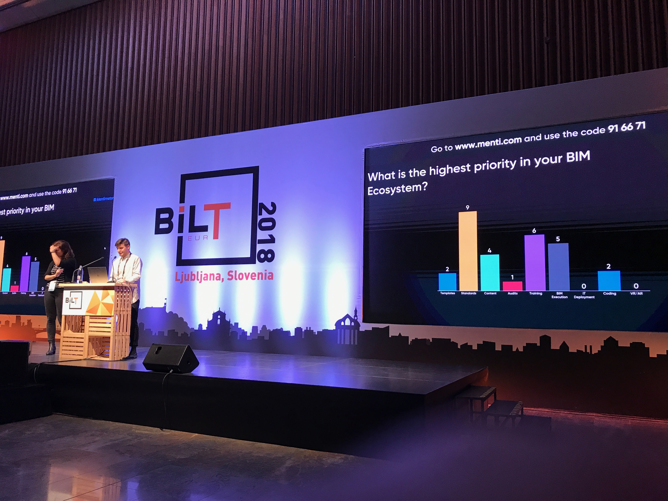
Do we need Standards?

Slide 6
Do we need Standards?

Slide 7
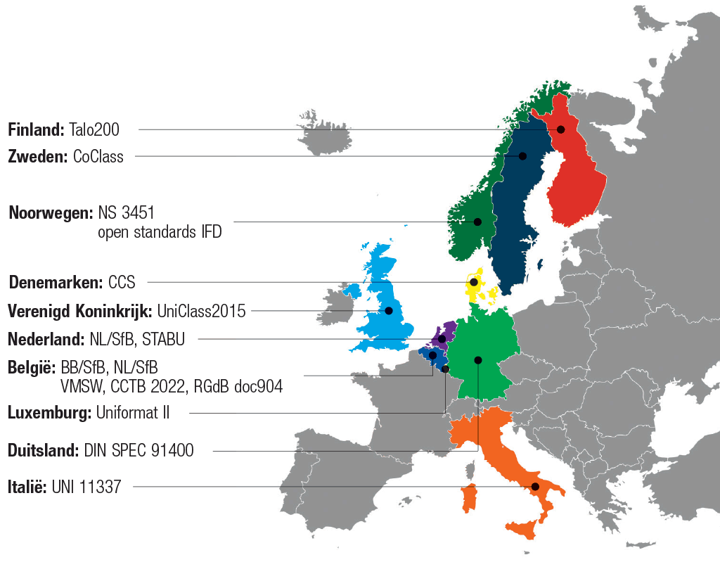

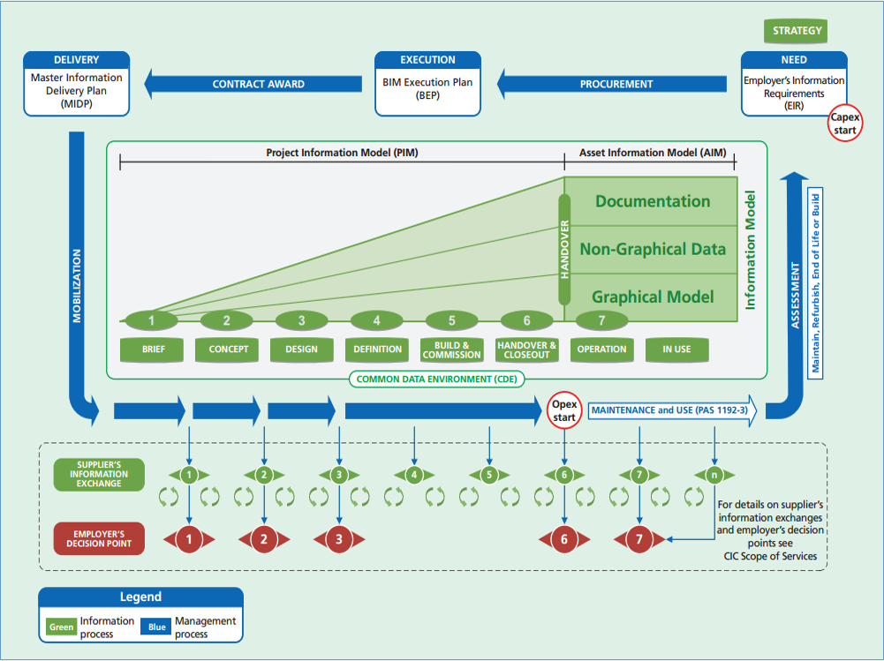

Types of Standards
Data
Semantic / Classification
Process / Protocols

Slide 8




Levels of Standardisation
International
European
National

Slide 9

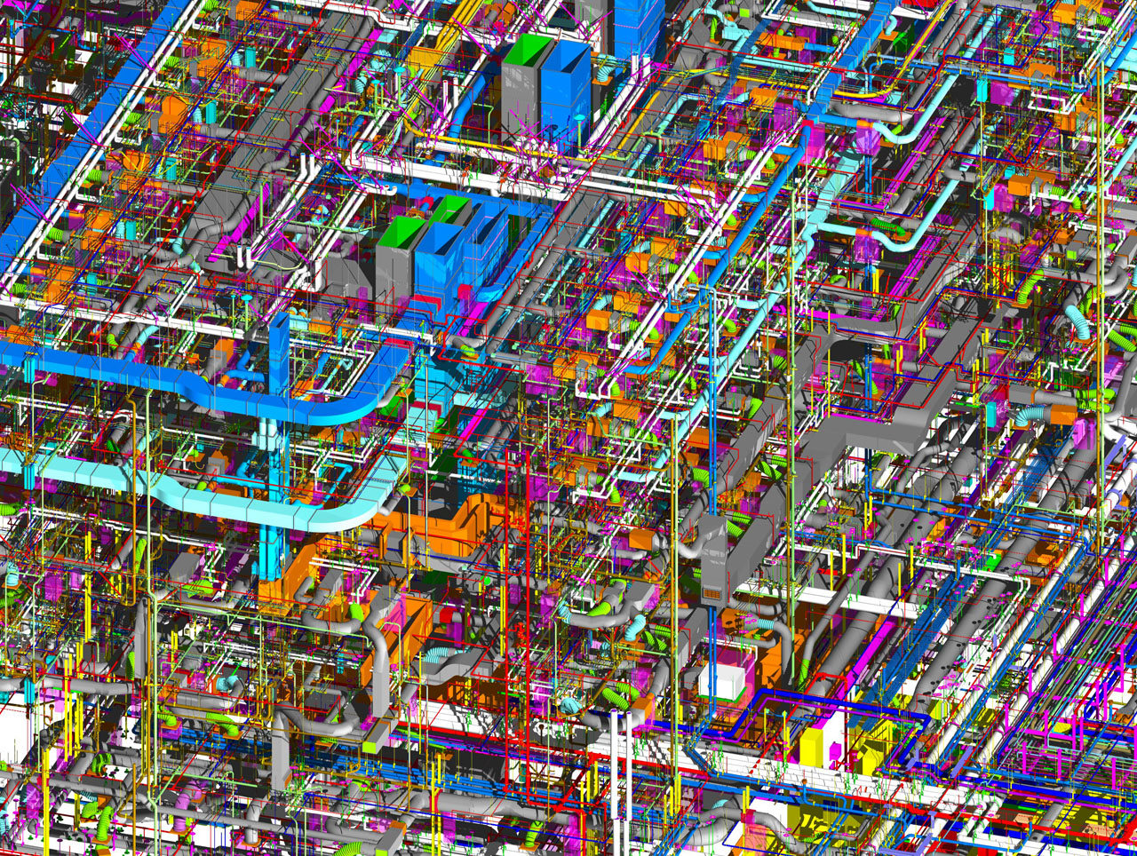

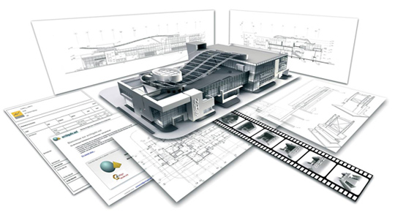
Levels of Standardisation
Project
Company
Individual

Slide 10
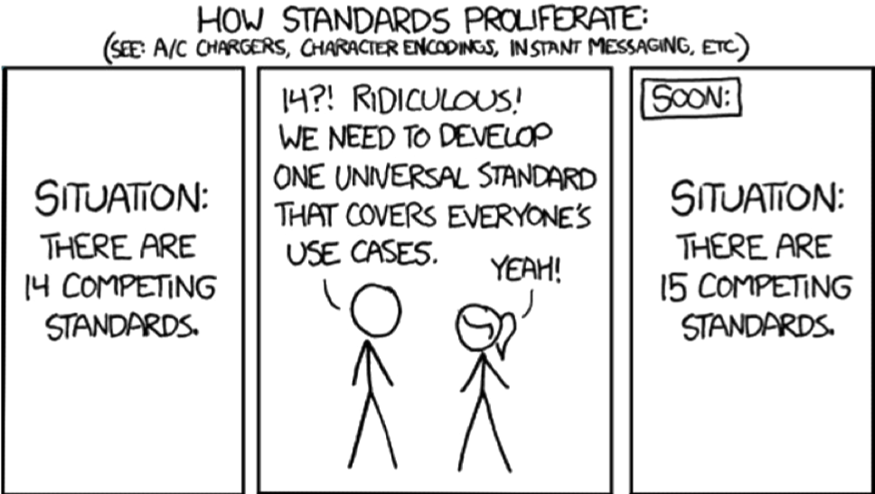
Implementation

Slide 11



How did it all start?
Martijn de Riet:
ESF Project -100 architecture firms to adopt BIM
Mark Wieringa:
Speaker at the RTC Australasia 2012
First Contact ANZRS

Slide 12



Revit Standards History
2012
2013
2014
2015
2018
Initiative
First Presentation
Public Beta 0.4
Public Beta 0.8
Release 1.0
First adoption RevitGG users
Release 2.0
MEP addition
Requirement in projects
Content Libraries
Wide adoption RevitGG users
Initiative Foundation
Revit Standards Foundation
Mention National BIM Protocol
Name change from DRS to NLRS
Recognition as Open Standard
Adoption as in industry standard
BERS
Doors family guide

Slide 13
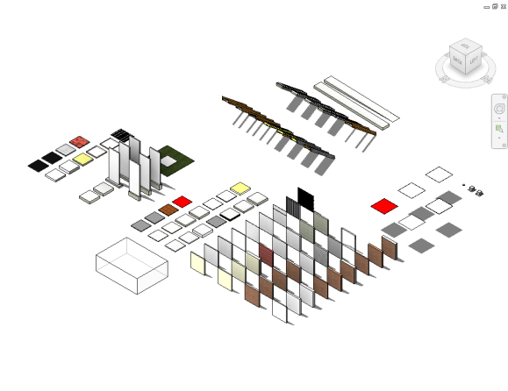
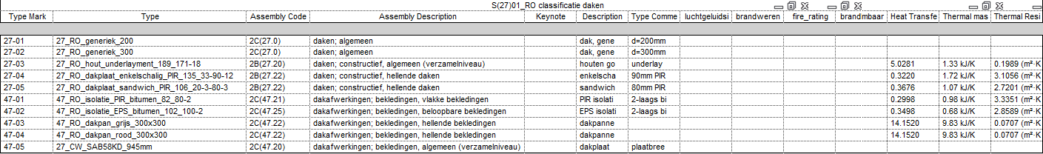
What are the Revit Standards?
Solution for the daily reality
No academic approach
Practical implementation of existing agreements, laws & regulations
Adherence to international standards
improve interoperability
Uniform content from providers
In short:
Good data management makes data reusable and makes it suitable for (re) use of information

Slide 14
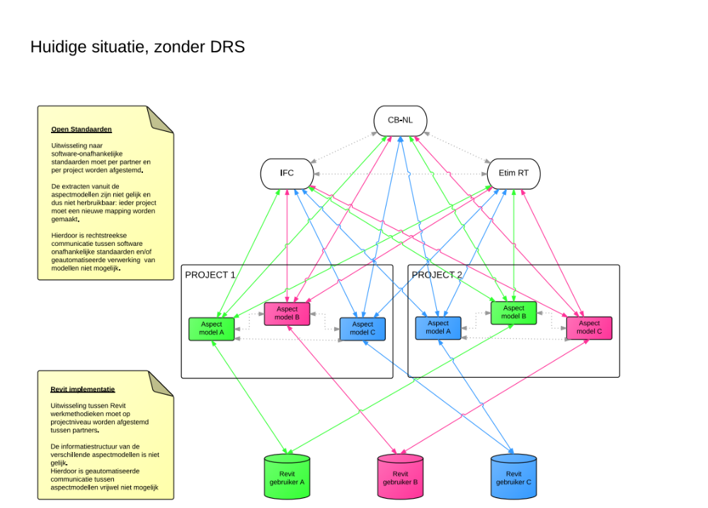
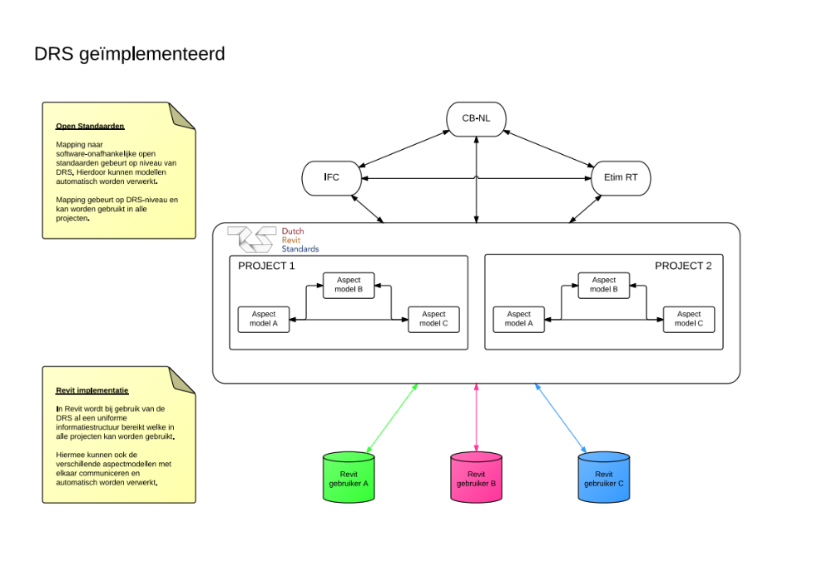
Why do we need it?

Slide 15
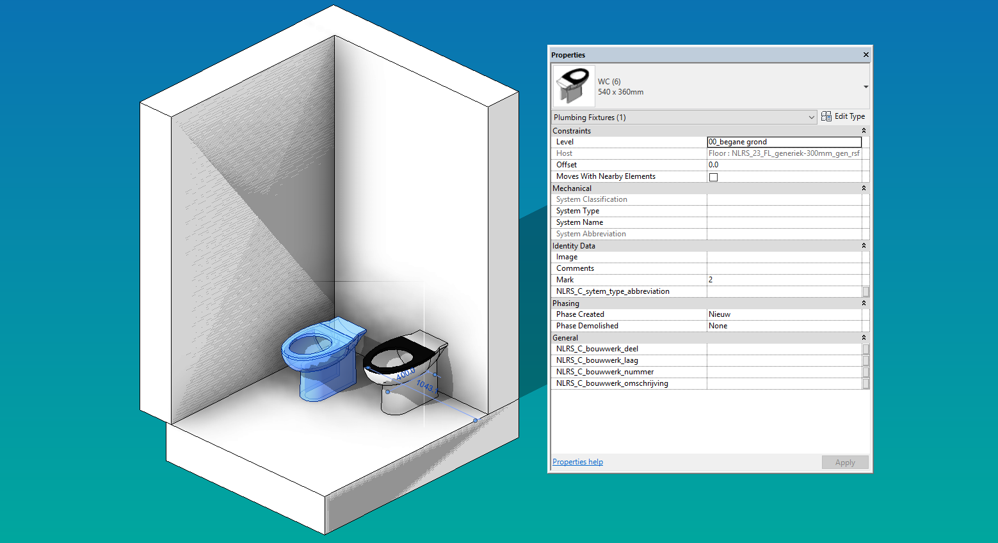
Why do we need it?

Slide 16
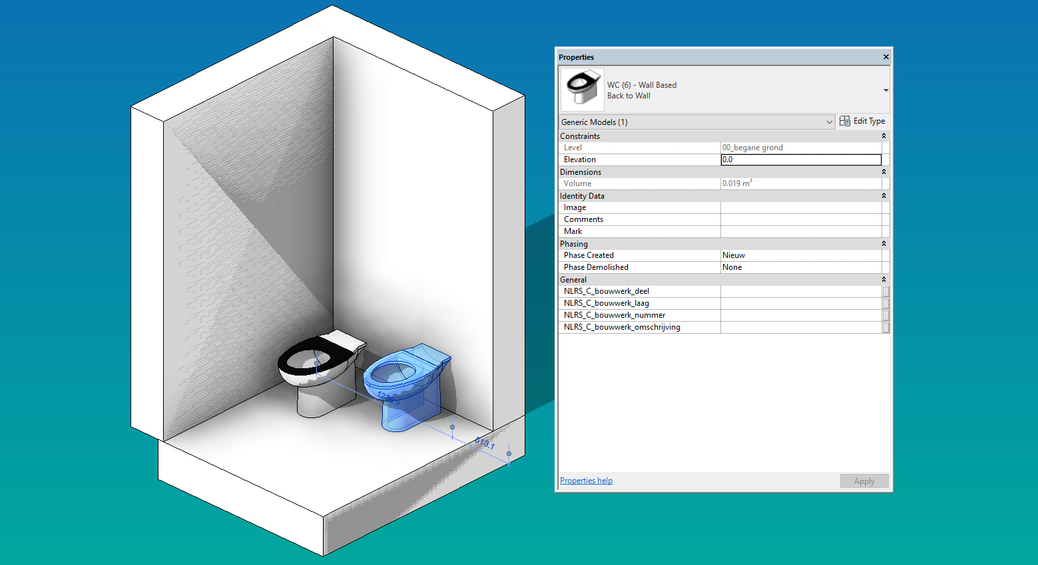
Why do we need it?

Slide 17
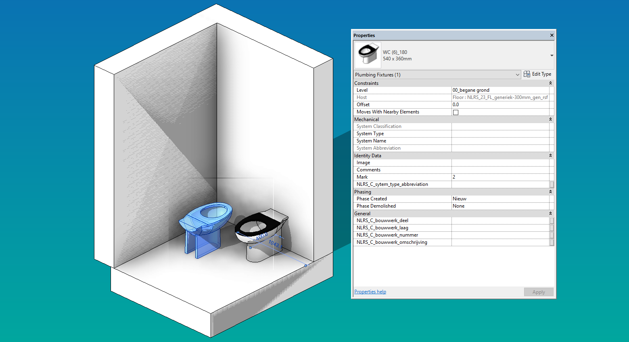
Why do we need it?

Slide 18
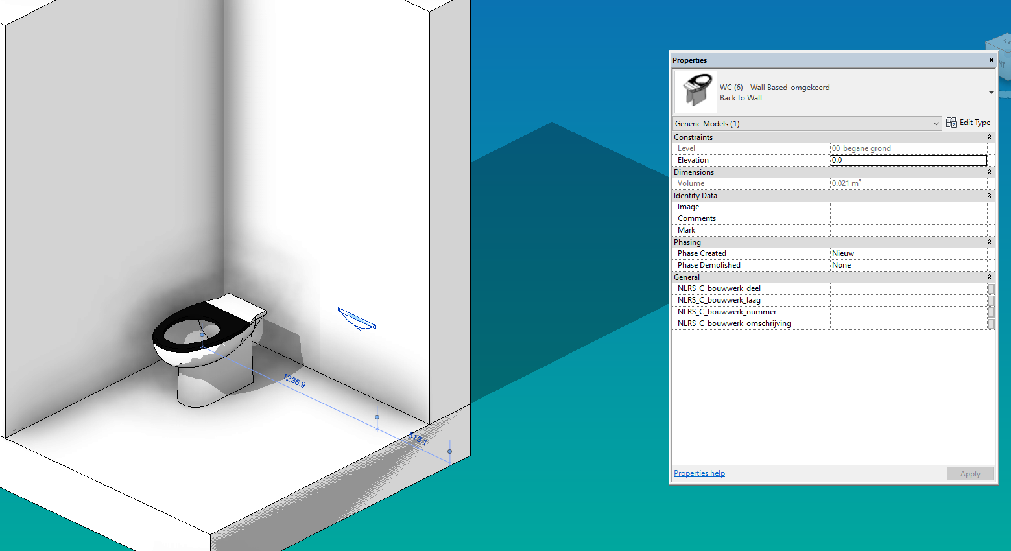
Why do we need it?

Slide 19
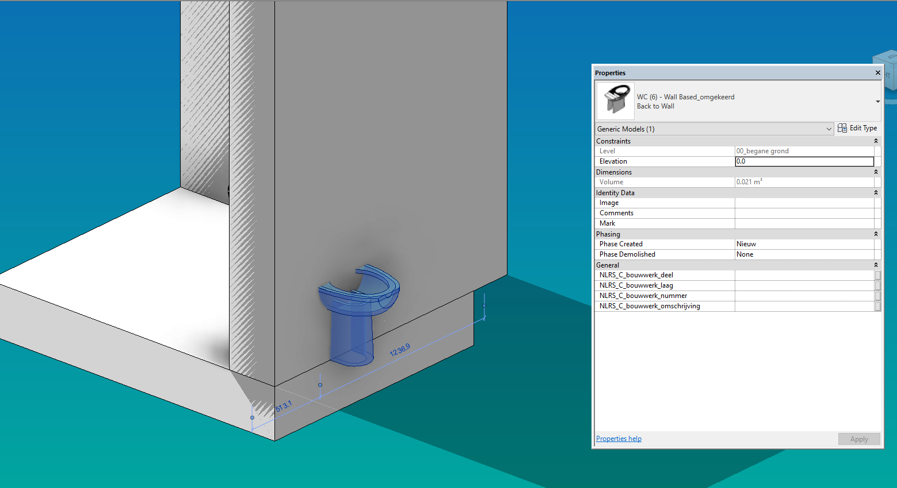
Why do we need it?

Slide 20
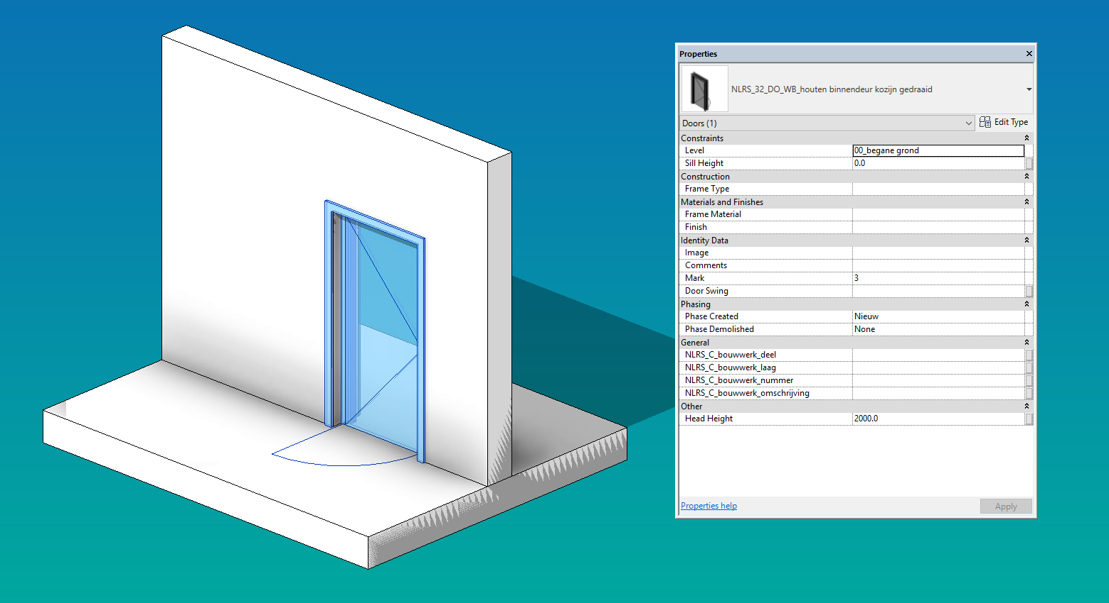
Why do we need it?

Slide 21
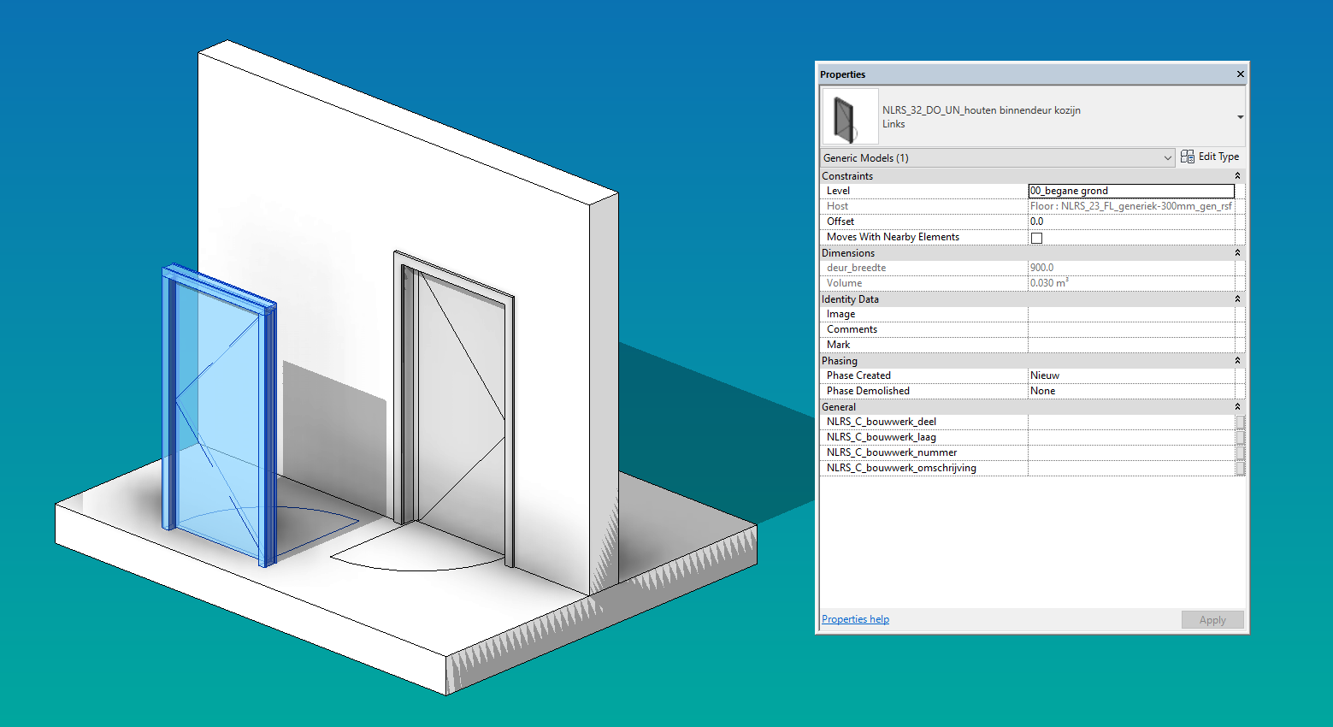
Why do we need it?

Slide 22
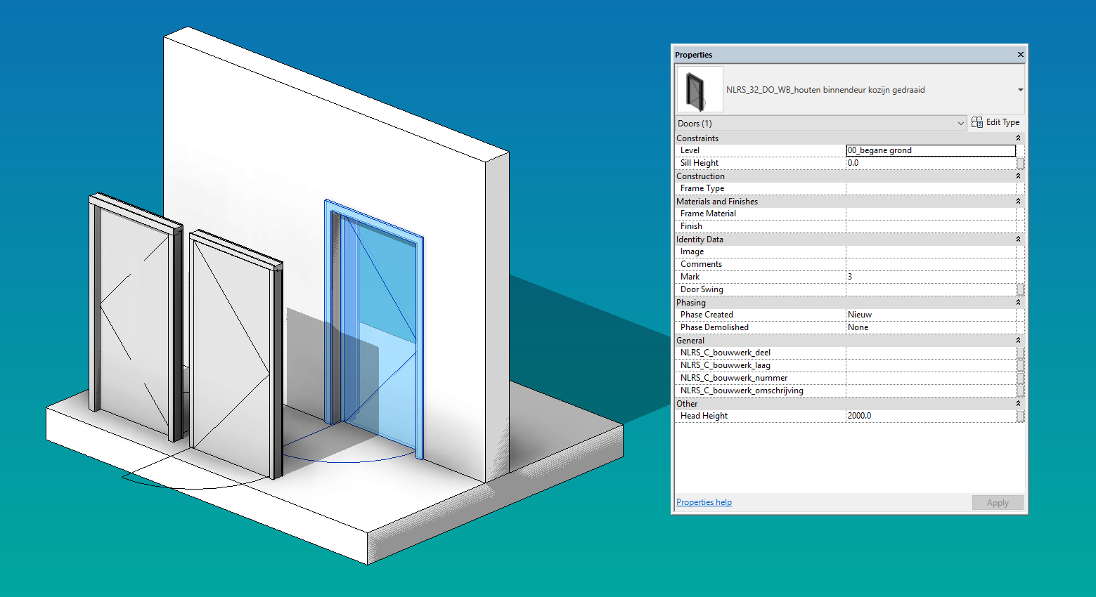
Why do we need it?

Slide 23
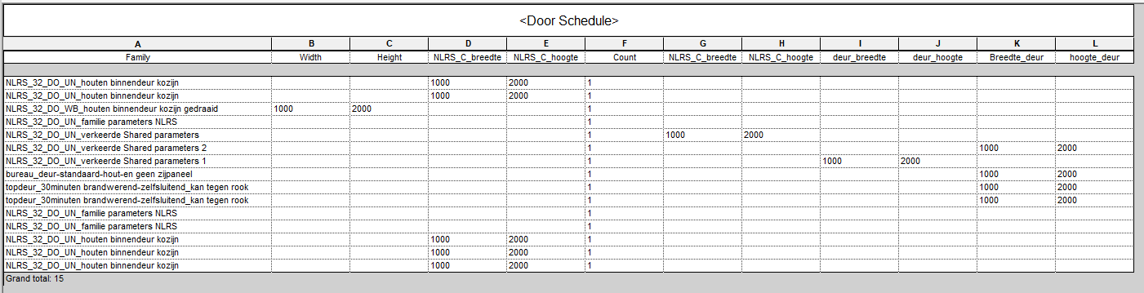
Why do we need it?

Slide 24
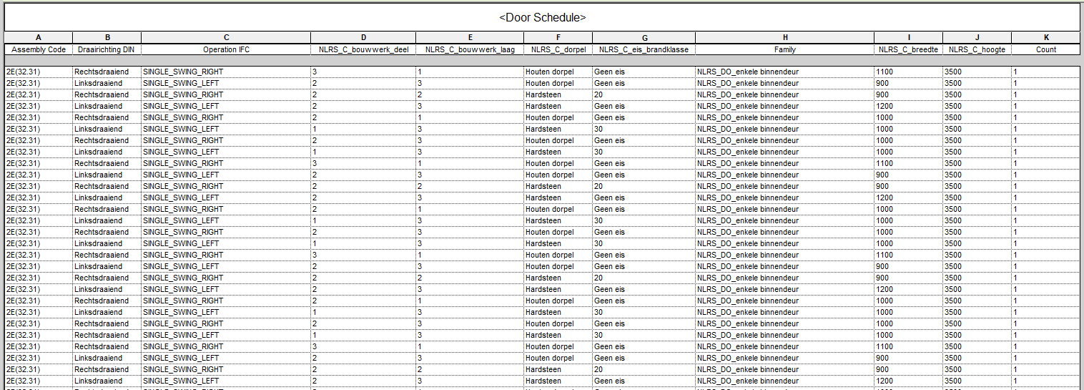
Why do we need it?

Slide 25






Naming Convention
_
_
_
_
_
_
1
2
3
4
5
6
7
Country
Classification
Revit Category
Revit behaviour
Description
Manufacturer
Content maker

Slide 26







Implementation of other Standards

Slide 27
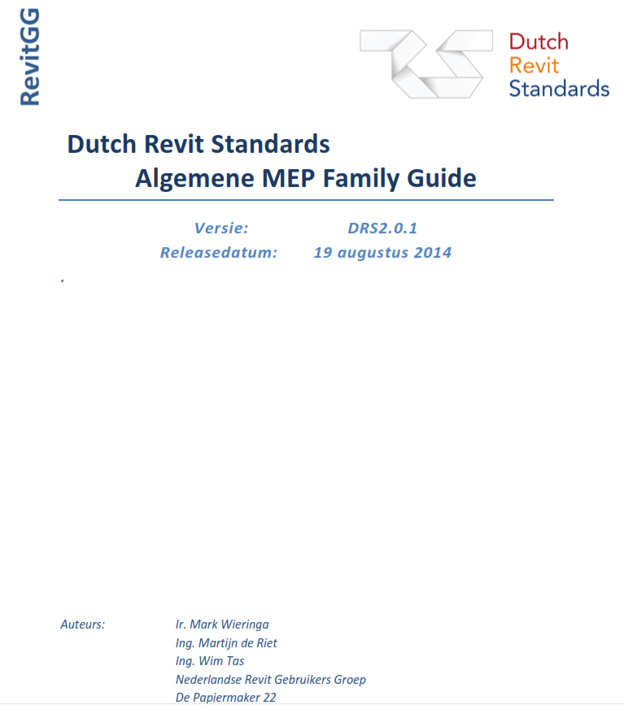




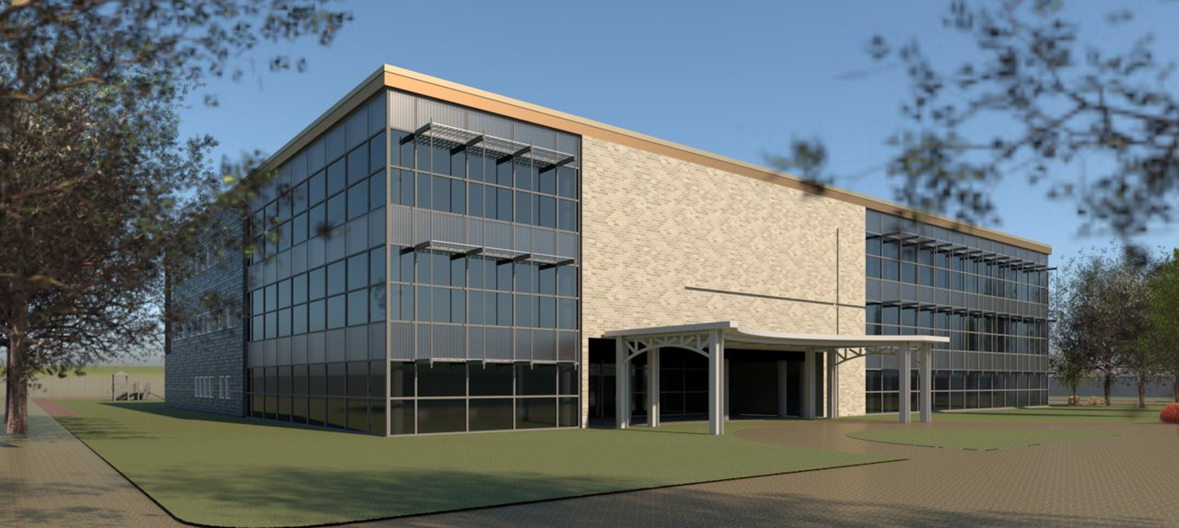
Revit Standards Documents
The NLRS 2.5.2
Family guide MEP
NLRS and IFC BIM basis ILS
Family guide Doors
NLRS Educational Model

Slide 28










Dutch Standardisation

Slide 29
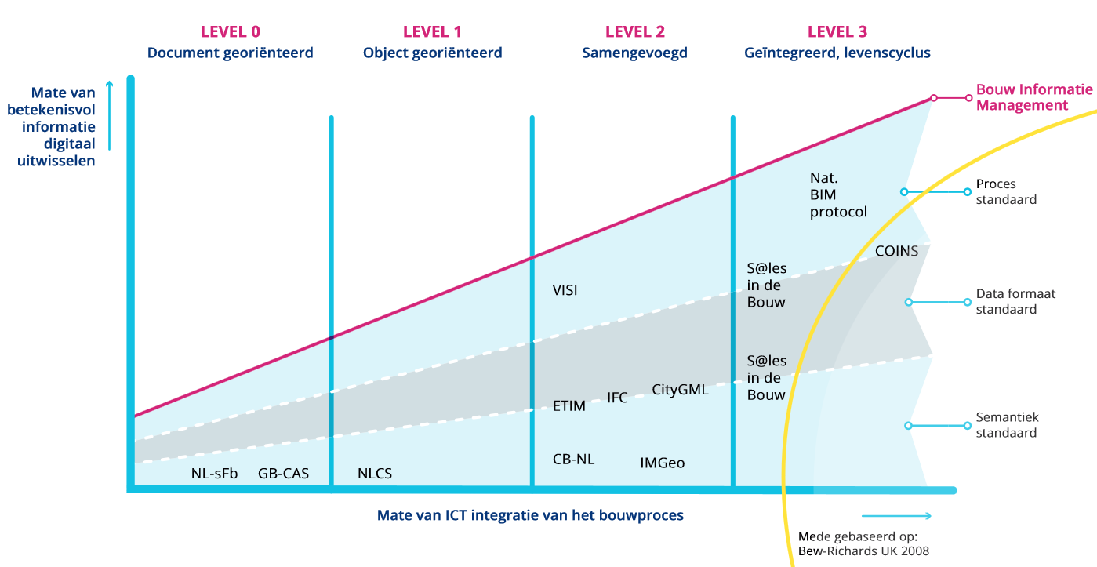
Types of Standards

Slide 30

The Dutch Standardisation Forum
The Forum was established by decree by the Minister of Economic Affairs on 27 March 2006 to ensure implementation of the policy on electronic data exchange and (re) use of data and electronic services.
https://vimeo.com/168315723

Slide 31
The Dutch Standardisation Forum
The Standardisation Forum supports the Dutch government in the development, use and establishment of open standards for electronic information exchange. In this way it promotes interoperability within the Dutch government system itself, but also in the relations between government agencies on one hand and citizens and enterprises on the other. The second goal of the Standardisation Forum is to prevent vendor lock-in and reduce costs in government spending on ICT.

Slide 32
The Dutch Standardisation Forum
The Forum has two lists of open standards:
Use or explain
Recommended open standards

Slide 33
The Dutch Standardisation Forum
The Forum set the requirements for recognition as an open standard by the Government:
Governing body
Independant Technical Committee
Public participation, expertgroups
Release cycle
Public access, documentation
Complaint procedure
Funding

Slide 34

The Dutch Standardisation Forum
Governing body
Independant Technical Committee
Public participation, expertgroups
Advisory Board
Board
Technical Committee
Expertgroup
Expertgroup
Expertgroup

Slide 35

The Dutch Standardisation Forum
Release cycle
Public access, documentation
Complaint procedure
www.revitstandards.org

Slide 36
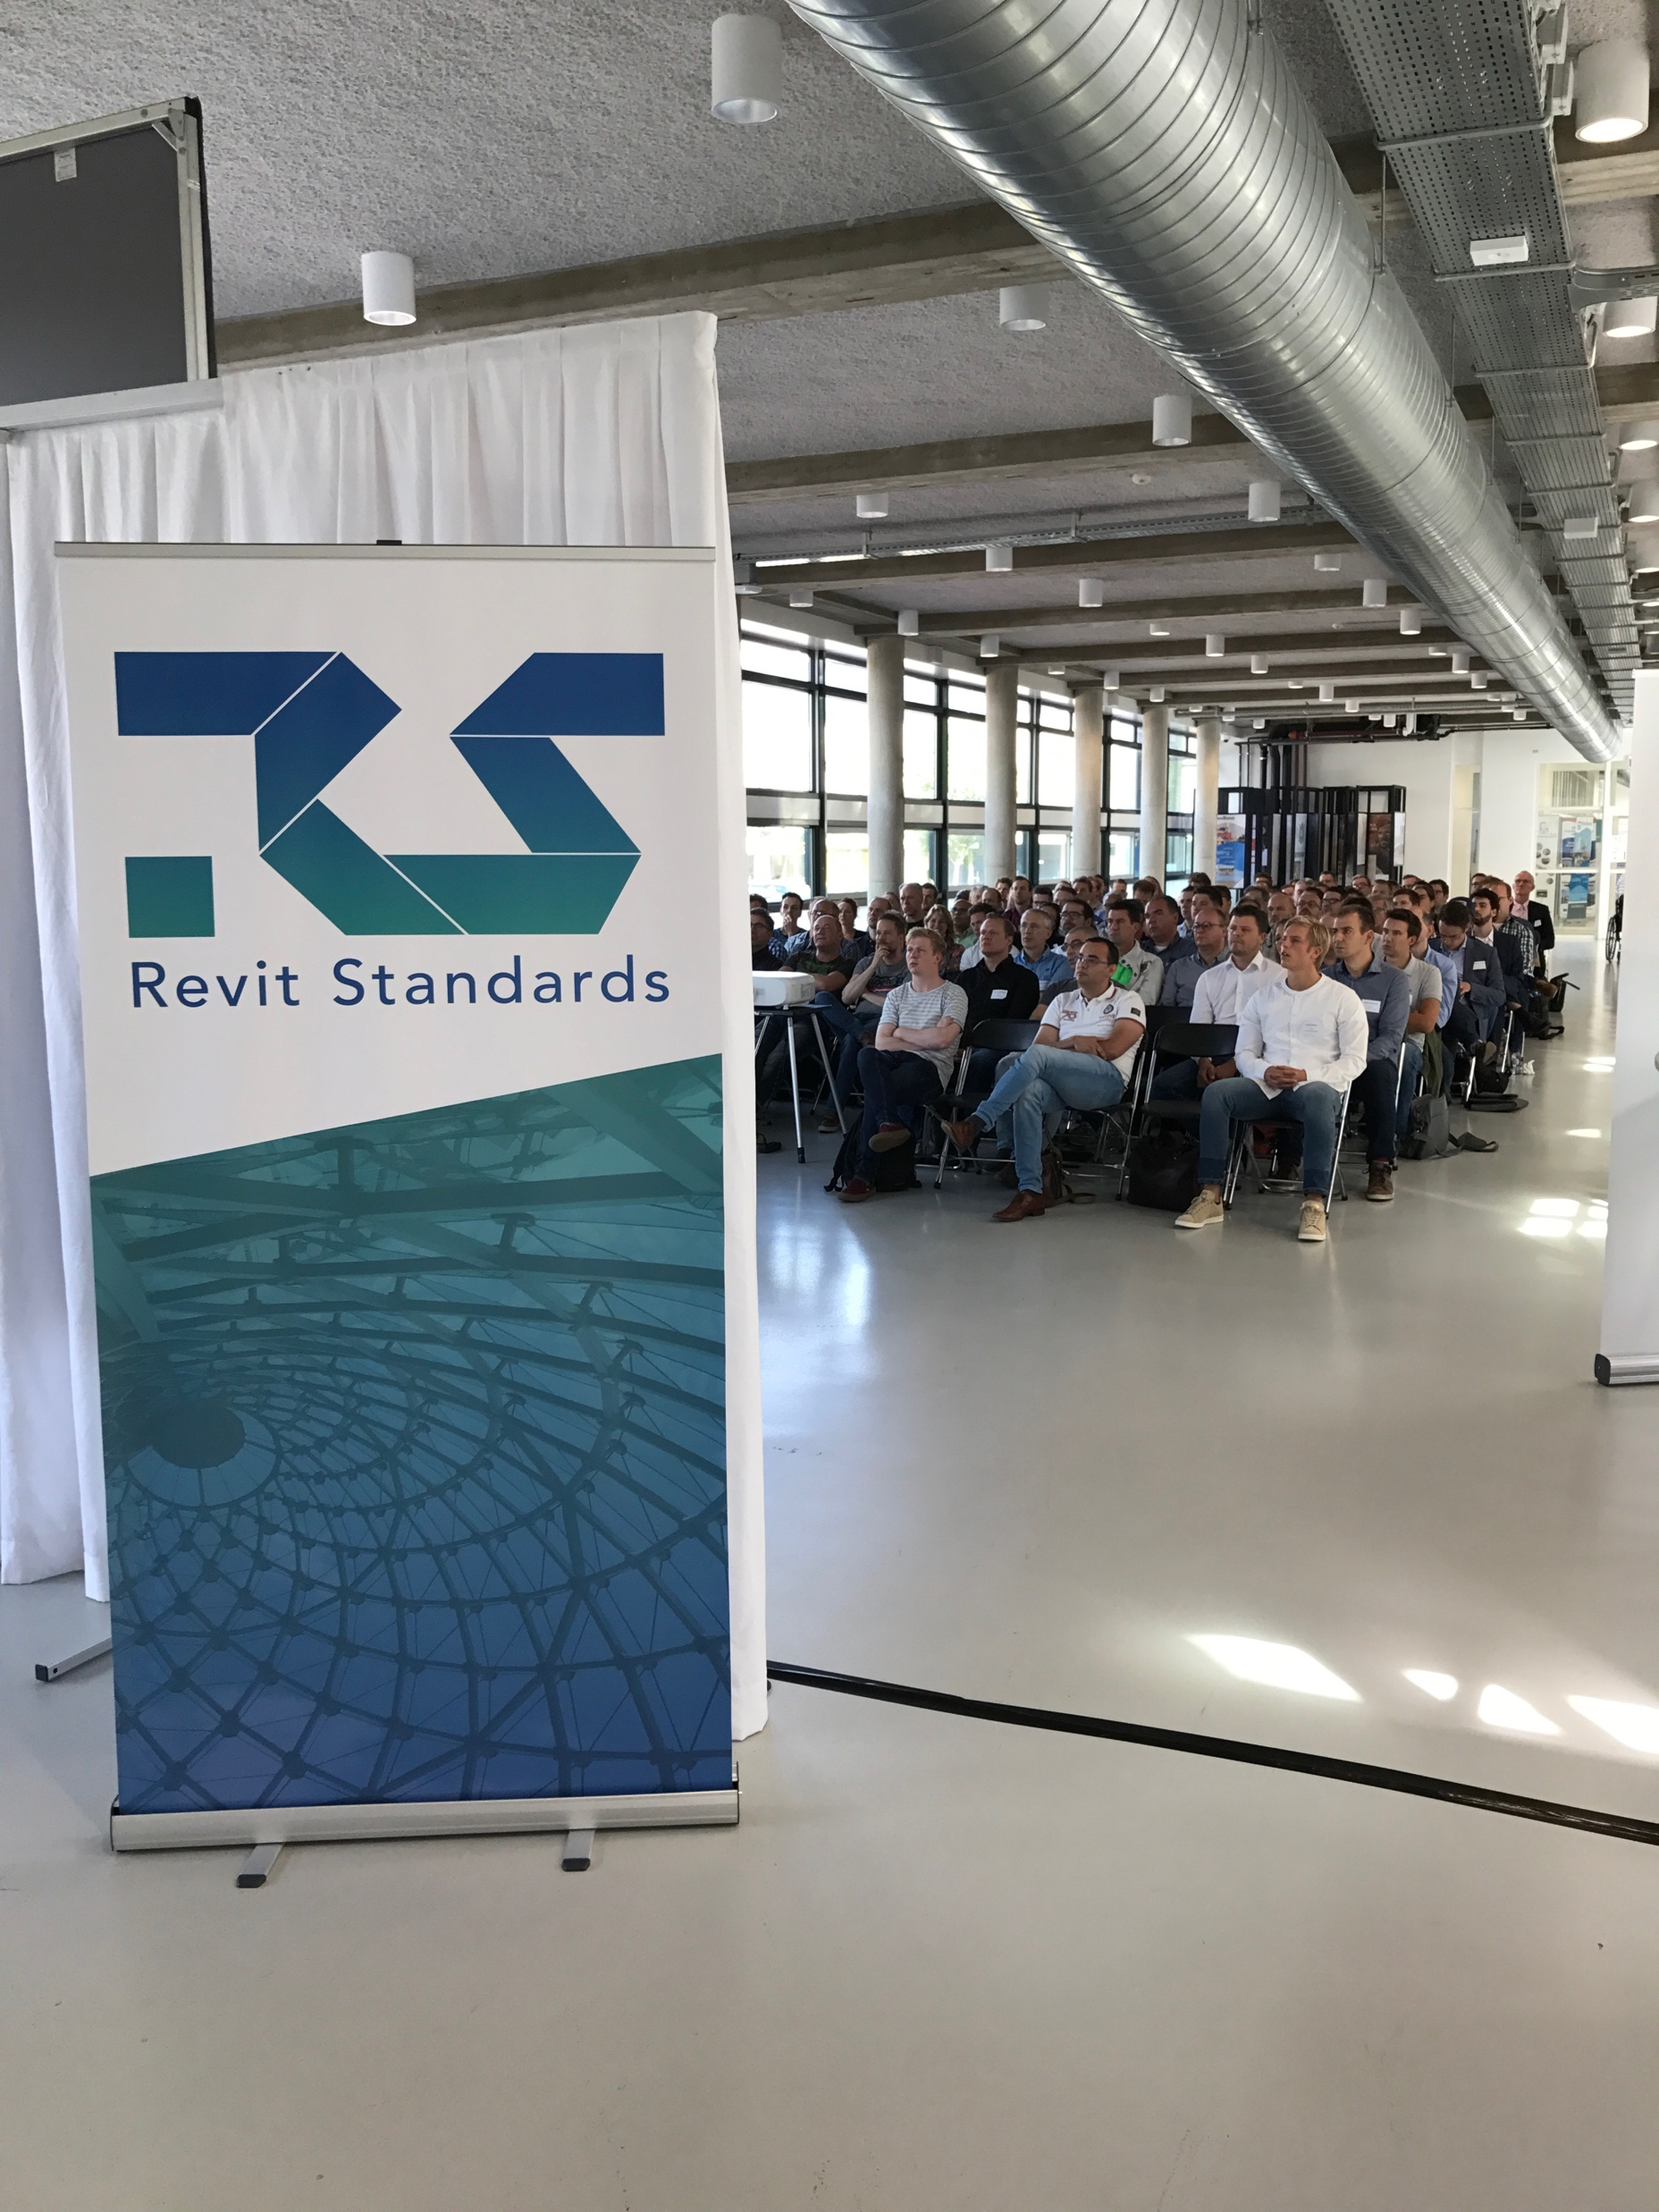
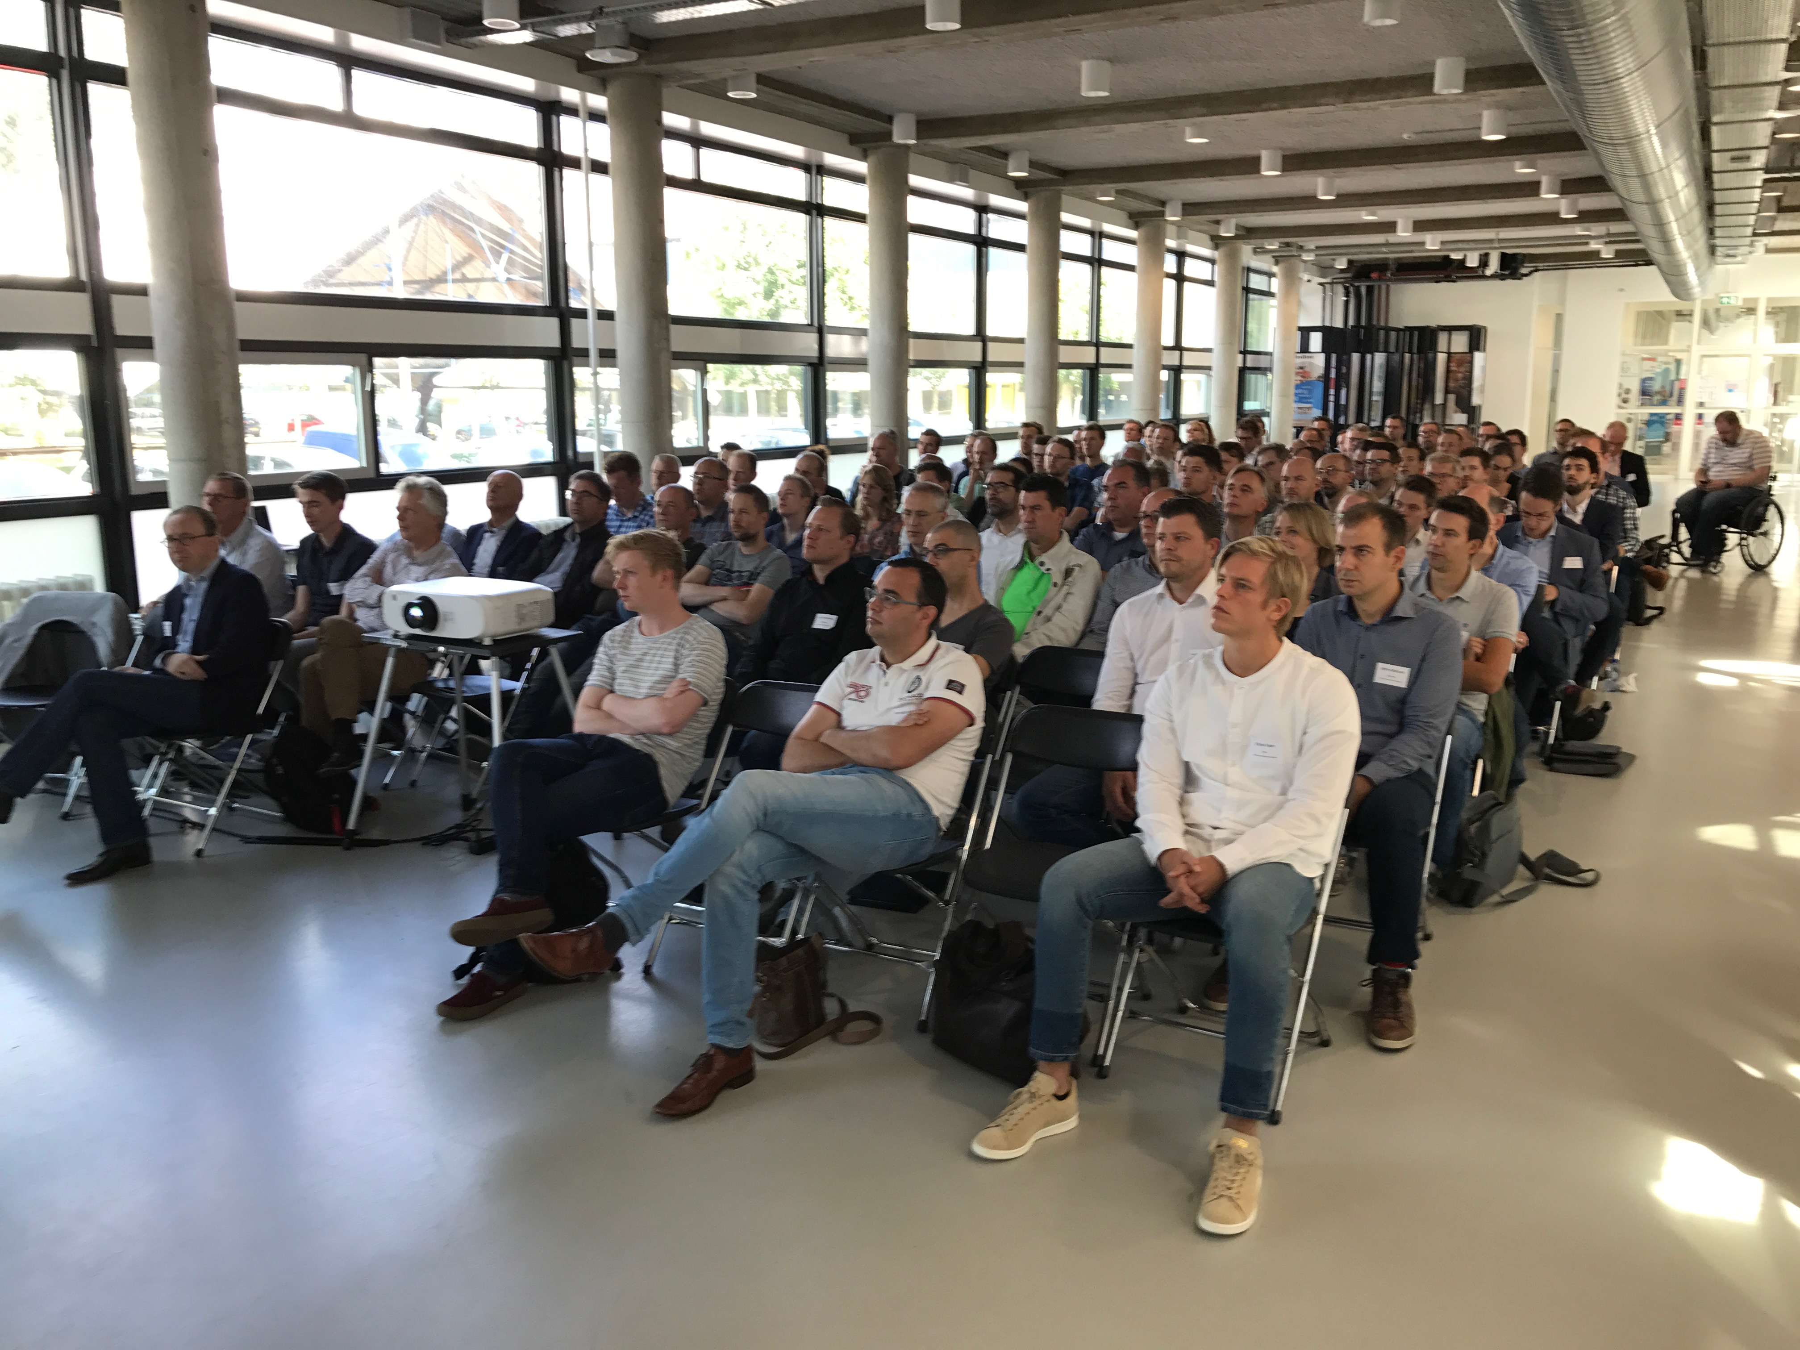
The Dutch Standardisation Forum
NLRS Users day 2017: 150 attendees

Slide 37
The Dutch Standardisation Forum
Funding
  International Stakeholders
  National Stakeholders
  Sponsors
  Donors

Slide 38


























Slide 39
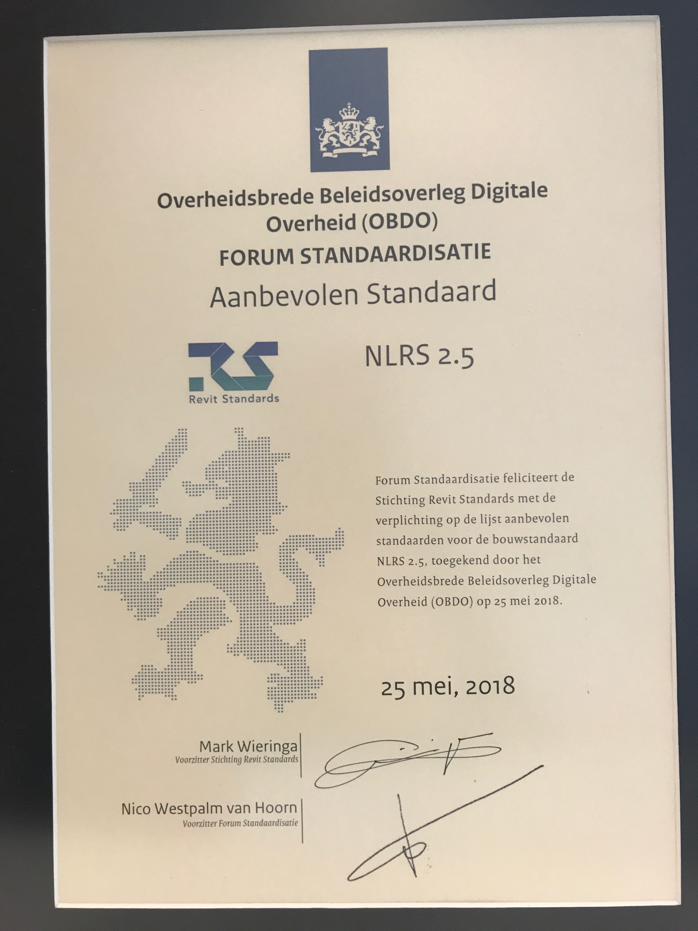
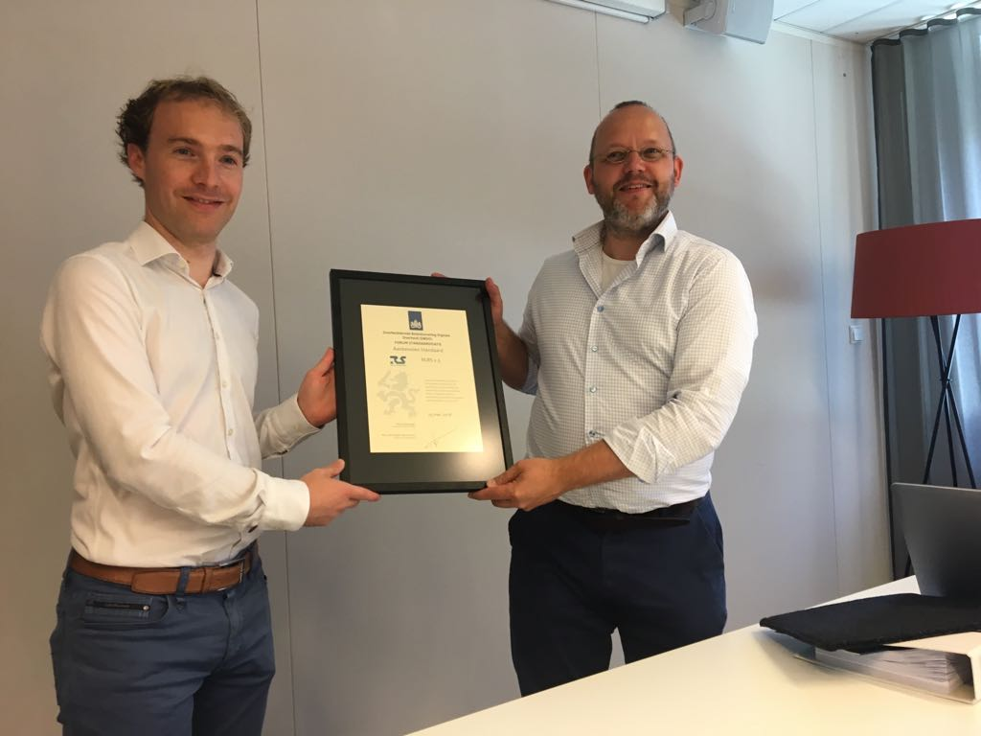
The Dutch Standardisation Forum
On the 25th of May 2018 the Forum has decided to recognize the NLRS as an open standard and has been added to the recommended open standards list.

Slide 40
Organisation
Advisory Board
  Chosen by stakeholders
  2 year term
  maximum 3 terms
Board
  Appointed by the advisory board
  3 year term
  maximum 2 terms
Technical Committee
  Individual appointment
Public participation
  Expertgroups
Advisory Board
Board
Technical Committee
Expertgroup
Expertgroup
Expertgroup

Slide 41
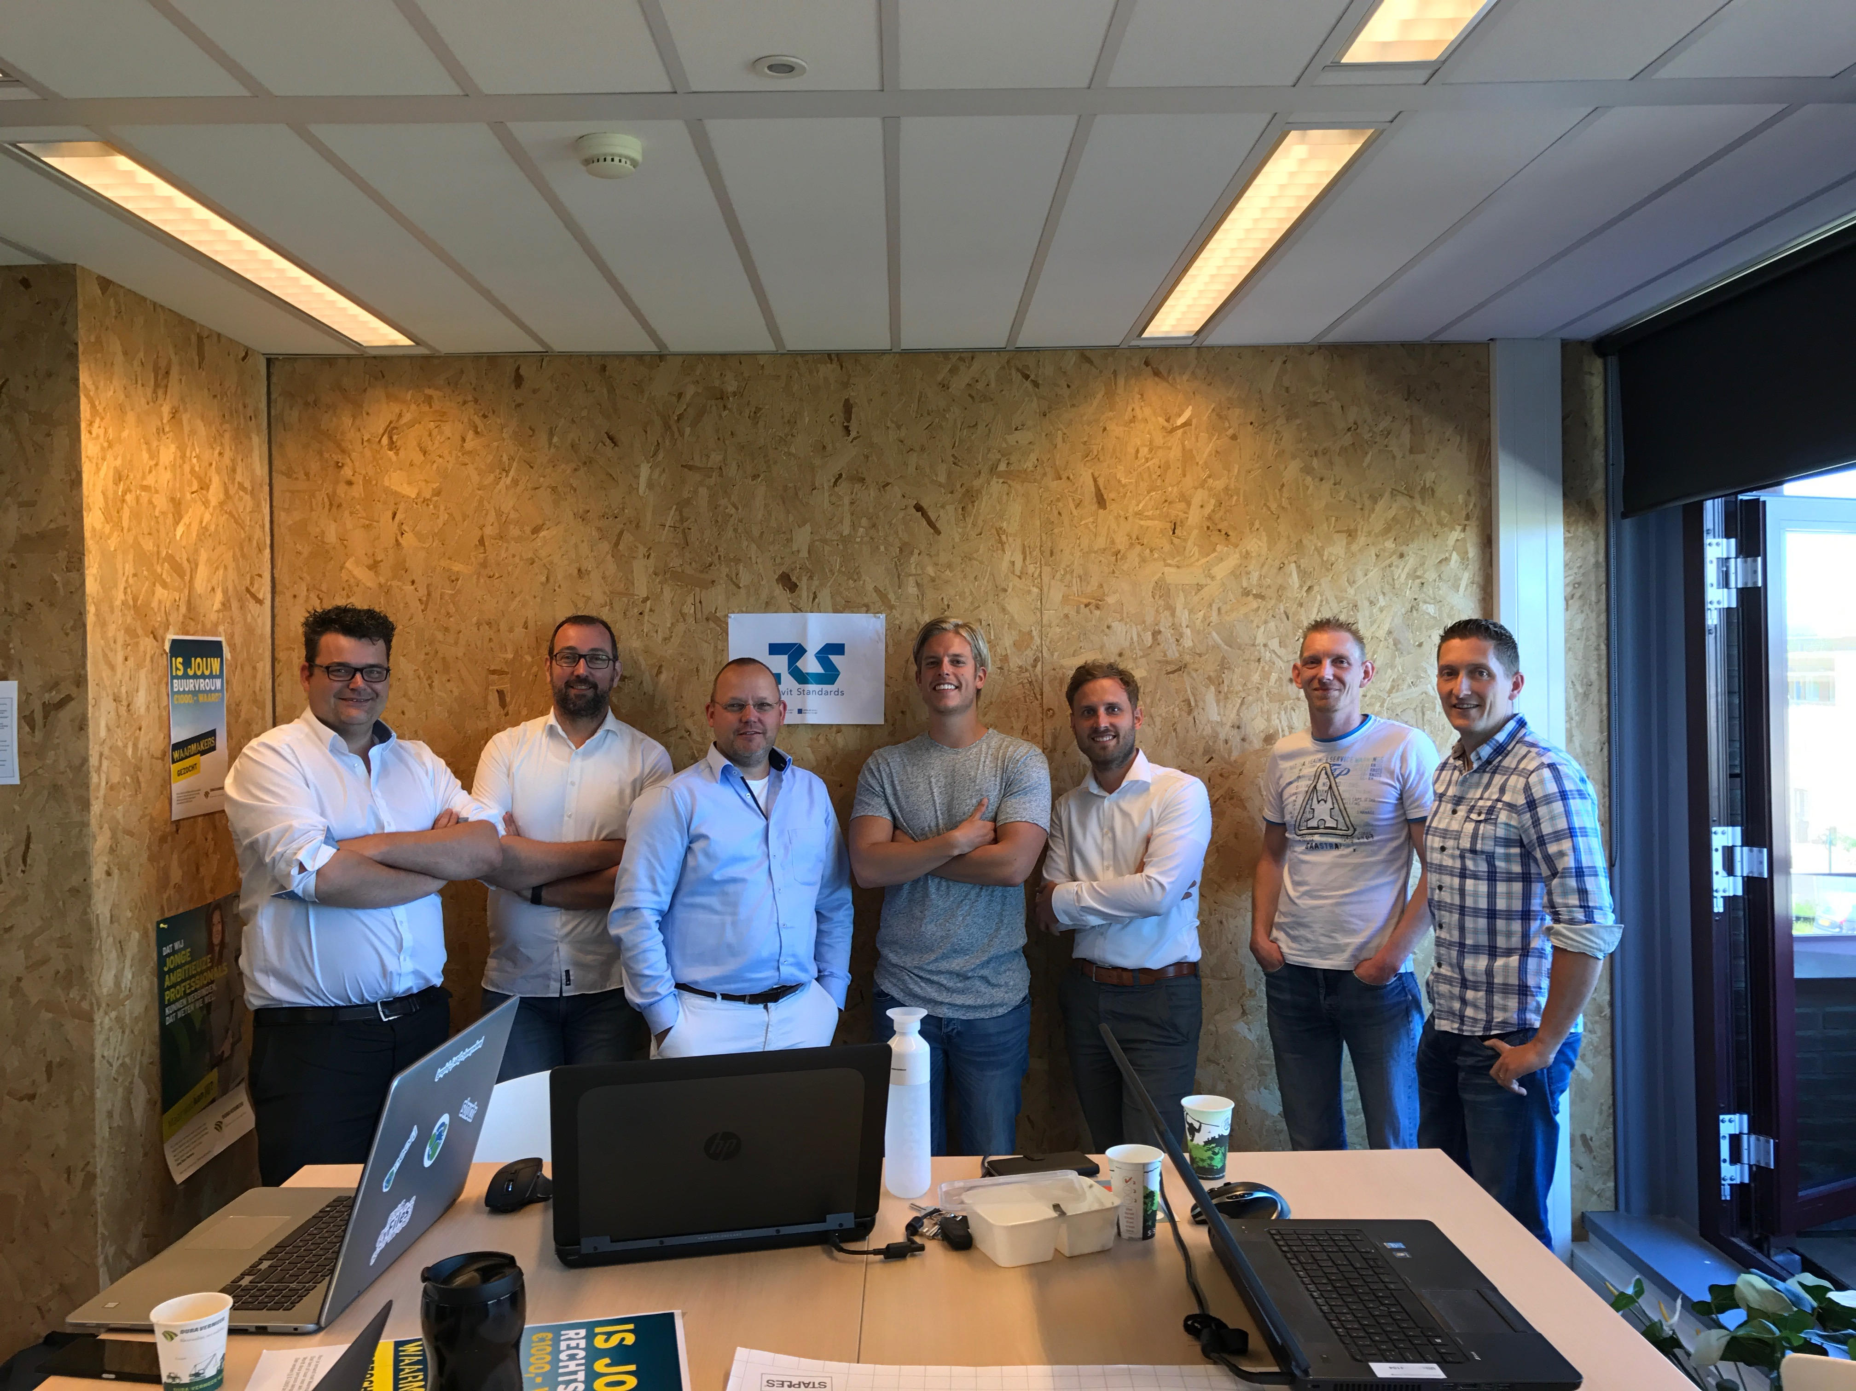
Technical Committee
Independent part of the RSF
Committee members are experts in their discipline
Committee members have been asked on a personal title
The technical committee represents the different branches of the AEC industry:
  Emiel Ham, voorzitter (Dura Vermeer, bouwkundig aannemer)
  Martijn de Riet, secretaris (Bimforce, software leverancier)
  Ron van Grinsven (BAM, integraal aannemer)
  Sietze Pars (ULC, installateur)
  Mark Wiefferink (Lukassen Bouwconstructies, constructeur)

Slide 42
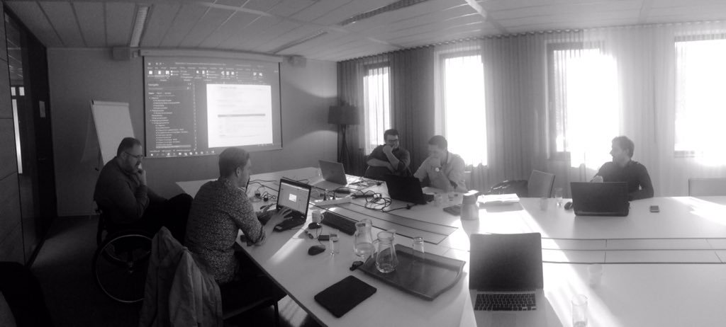
Technical Committee
Tasks of the Technical Committee
Maintaining the (NL)RS
Develop new parts of the (NL)RS
Review proposals for addition to the (NL)RS
Making the (NL)RS Documentation
Communication with end users, answering question

Slide 43
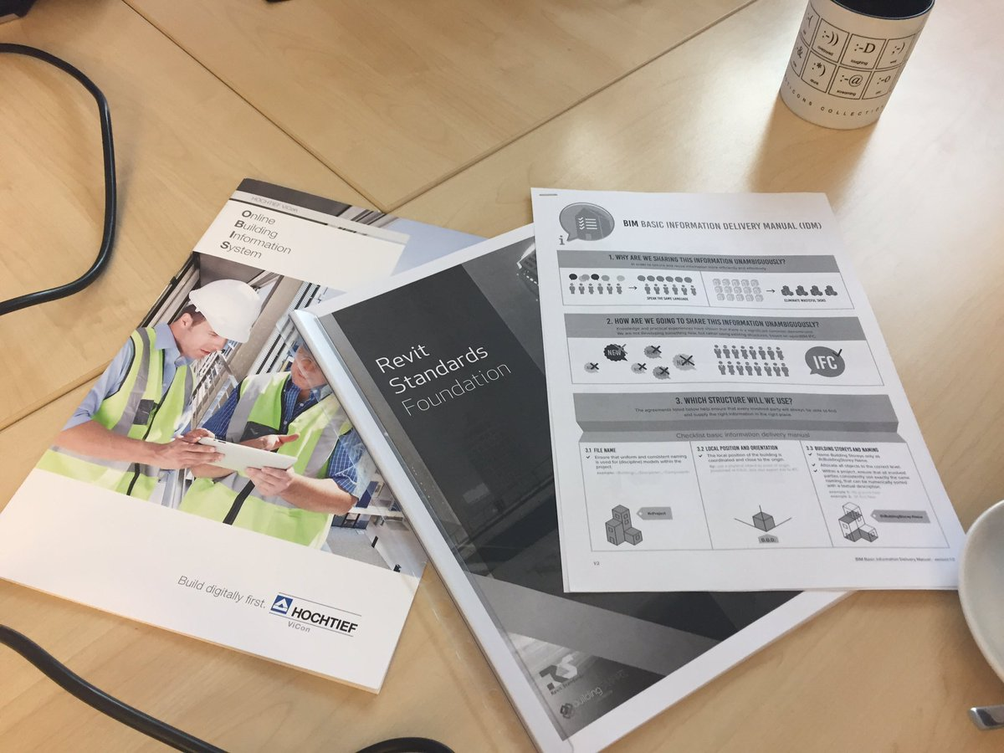
Technical Committee
Daily Practise
Monthly meetings
Work on projects for the RSF
Projects are being assigned to 1 or 2 members of the Technical Committee, they are responsible
Supervising expert group meetings

Slide 44
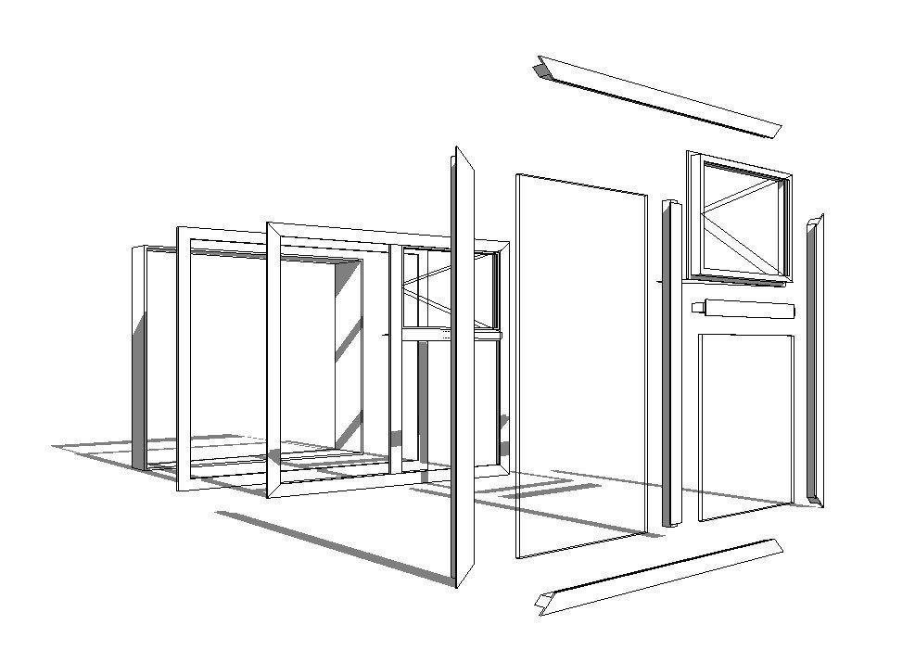
Advancing the Standards
RSF Projects
Receiving a question from the market
The Technical Committee reviews:
  Relevance “Is it an addition to the standard?”
  Is there enough support from stakeholders?
  What is the urgency?
The Technical Committee writes a project execution plan
The project execution plan is reviewed by the Board

Slide 45
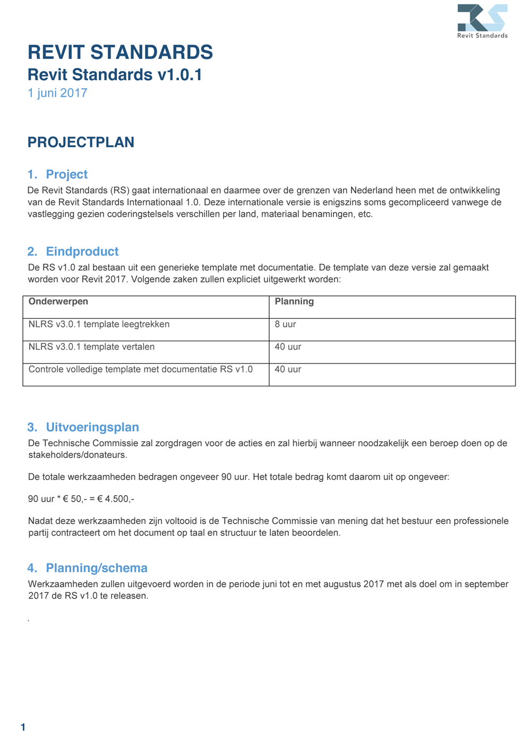
A Project Execution plan
The problem
  Which question needs to be answered?
Organization
  Is it dealt with internally within the Technical Committee (small changes)?
  Is there a need for an expert group?
Which Technical Committee member is responsible?
What is the expected scope of work?
What are the preliminary planning and budget?

Slide 46
Execution of a project plan
Project can start after approval from the Board
Internal project within the Technical Committee are being planned and executed
When there is need for an expert group
  Assign a Technical Committee member the project
  Invite experts to join the expert group
  Appoint a chairman of the expert group
  Setup a meeting schedule
  Agree on a plan of action within the expert group
  Monitoring and reporting to the Technical Committee

Slide 47
Results for the expert group
Review the deliverables according to the execution plan
  Are the requirements met
A review by the entire Technical Committee
  When approved the deliverables are being sent to the Board
  When not approved they are being sent back to the expert group
A Review by the Board
  When approved the project is a go
  When not approved the Technical Committee is provided a list of remarks
    The Technical Committee can address them
    The remarks can be passed on to the expert group

Slide 48
Publication
  All changes and addition to the (NL)RS need to be presented for public consultation by the Stakeholders
  There is a 6 week response
  All remarks from the publish consultation are being addressed by the Technical Committee
  When there are no more remarks Stakeholders vote on the addition to the Standard
  The Technical Committee publishes the new version of the (NL)RS

Slide 49

Expert groups
Who particaptes in an expert group
1-2 Technical Committee members (as monitor and for questions)
Experts from the Industry
Stakeholders
Open to anyone interested (usually trough the Revit Usergroup)
Why participate in an expert group
All Stakeholders have voting rights
Help develop new additions to the (NL)RS
Peer group for discussion

Slide 50


Active Projects
BERS
Submitter for review by the Technical Committee
Family guide Doors
Being reviewed by the Technical Committee
Revit Standards international 1.0
Start project execution plan
(NL)RS Digital Documentation system
Being developed by the Technical Committee
NLRS - IFC asset property mapping
Project execution plan approaved by the Board
Belgische

Slide 51
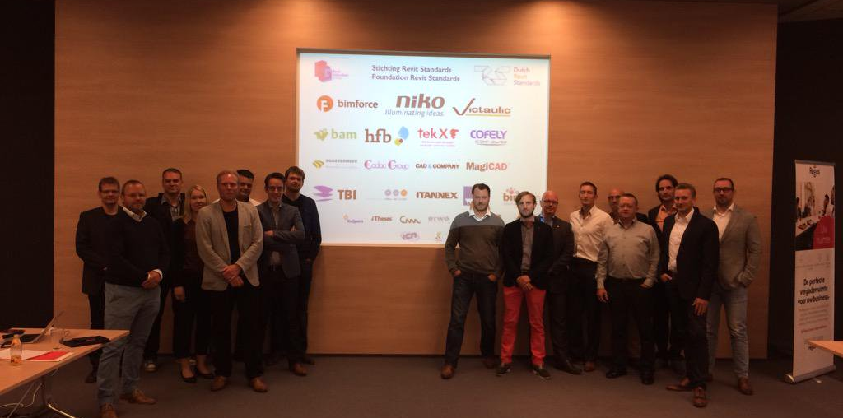
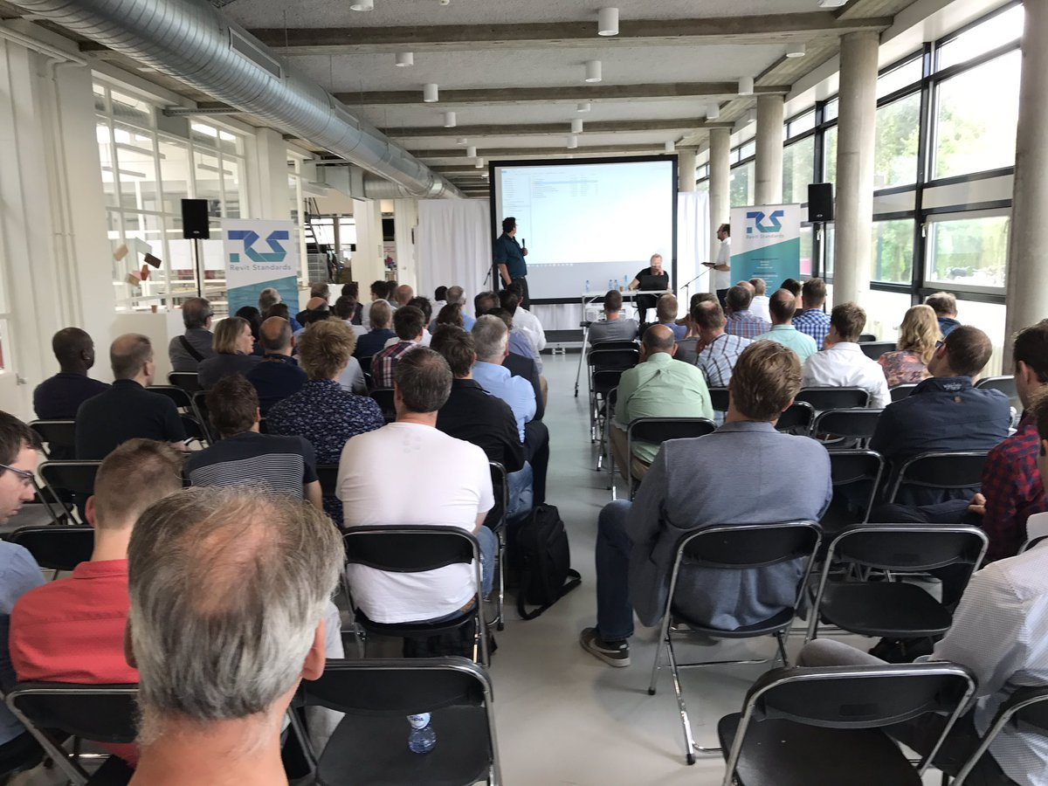
Revit Standards Foundation
www.revitstandards.org
@revitstandards
Secretary@revitstandards.org
TC@revitstandards.org

Slide 53
REMINDER:
Speaker Feedback is appreciated
Fill in the Survey on the Mobile App

Slide 54
The Revit Standards officially recognised as an Open Standard
Mark Wieringa
Revit Standards Foundation, Bimforce
@revitstandards @m_wieringa

